Slide 1

Breast cancer detection using Convolutional Neural Networks
Pavel Makarov

Slide 2

Agenda
Introduction and Problem Statement
Data Description
Methods
Analysis
Conclusion

Slide 3
Introduction
Breast cancer accounts for approximately 30% of all new female cancer cases annually, making it the most common type of cancer in women.
The human eye can not always detect minor changes at the early stages
Modern Convolutional Neural Networks can find patterns and changes in the image that are relevant to malignant types of tumor
This project can serve as an additional tool to previously developed classification model based on nuclei laboratory testing results

Slide 4

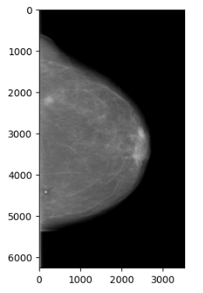
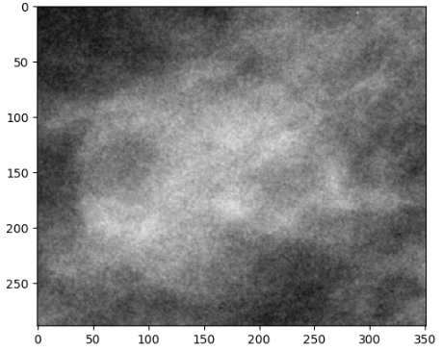
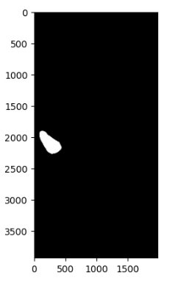
Data selection
The curated Breast Imaging Subset of the Digital Database for Screening Mammography (CBIS-DDSM) data set was obtained from Kaggle
It consists of jpeg format images and tabular data in csv format.
There are 6774 pictures of three types
Full mammograms Cropped images ROI mask images

Slide 5
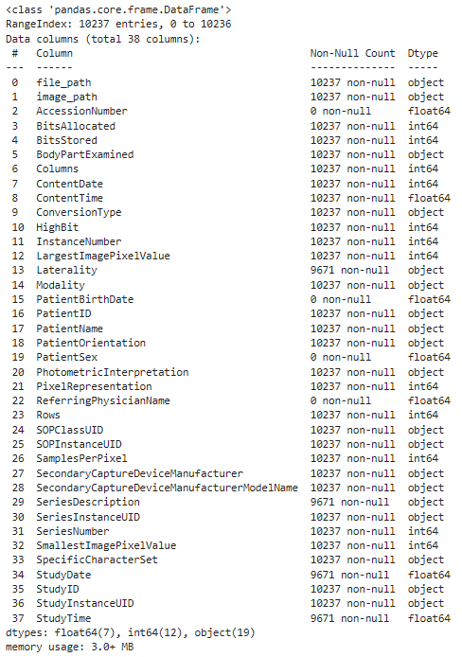
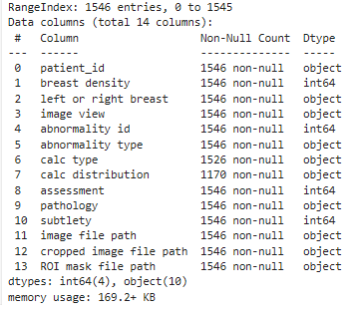
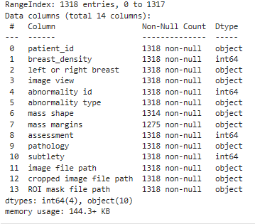
Tabular data description
DICOM data
Calcification data
Mass data

Slide 6
Data Preparation
The tabular data corresponding to calcification and mass features were split into two CSV files
-Training and test
Those file were concatenated into one combined file
Then calcification and mass data frames were also combined into one finalized data frame
Missing values were dropped
The file paths to the corresponding pictures were changed based on the location on the local drive

Slide 7
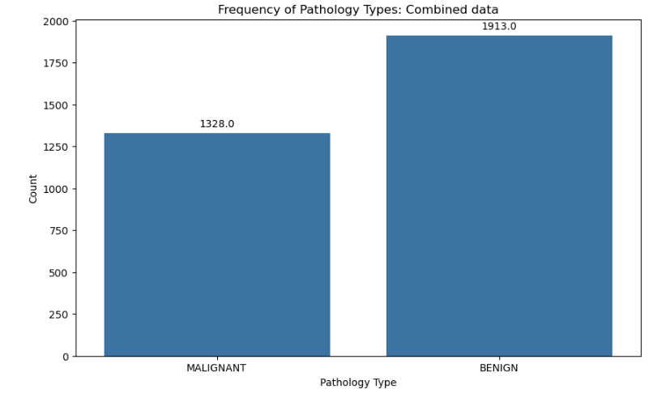
TARGET FEATURE ANALYSIS
41%
59%

Slide 8
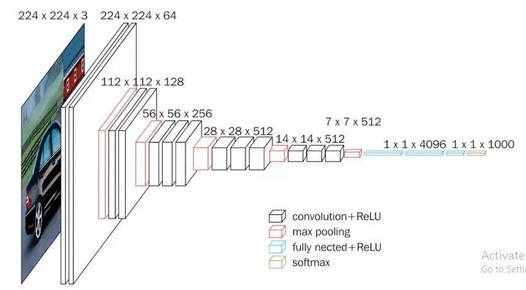
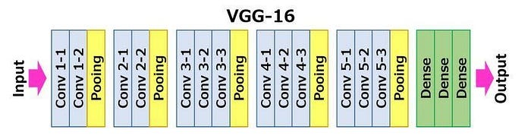
Modeling
VGG16 model architecture
The VGG-16 architecture is a deep convolutional neural network (CNN) designed for image classification tasks.
The Visual Geometry Group introduced it at the University of Oxford
The VGG-16 configuration typically consists of 16 layers, including 13 convolutional layers and 3 fully connected layers. These layers are organized into blocks, with each block containing multiple convolutional layers followed by a max-pooling layer for downsampling.

Slide 9
MODEL TRAINING PARAMETERS
Model: VGG16
Early stopping: Stop when the accuracy change is 1e-4 within 5 epochs.
Learning rate plateau: Minimum learning rate is 1e-6
Learning stopped at the 19th epoch

Slide 10
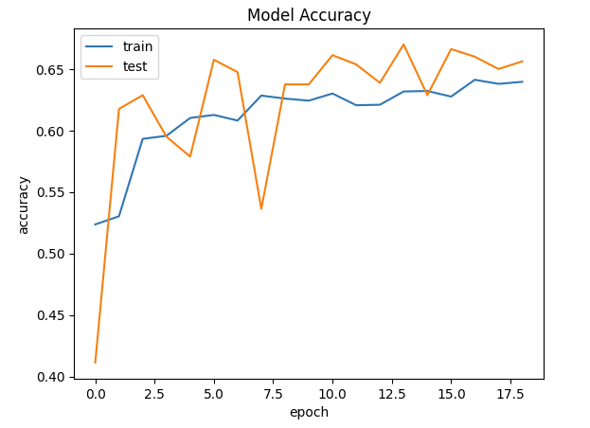
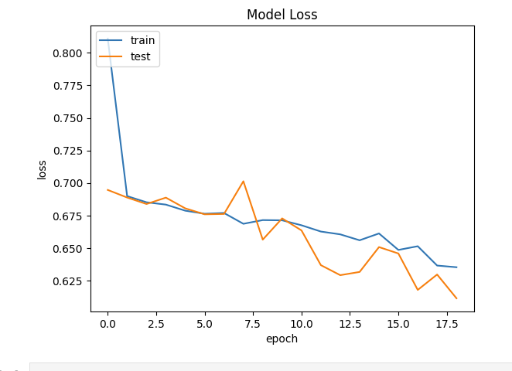
MODEL EVALUATION

Slide 11
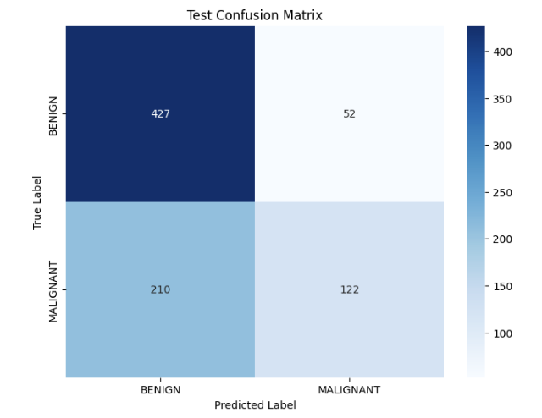
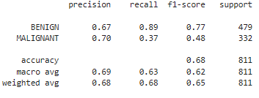
MODEL EVALUATION

Slide 12
CONCLUSION
The overall model performs decently in breast cancer detection. It can reliably identify benign cases; however, some false positive cases exist. The overall precision is 0.67. Additionally, in the Malignant cases, the model has decent precision but low recall, indicating many false negatives. Further model tuning is required to improve performance.

Slide 13
THANK YOU
Pavel Makarov
mack7151@gmail.com
https://www.linkedin.com/in/pavelmakarov90

